Slide 1
WELCOME

Slide 2
Introduction
For reducing carbon footprint, better to use renewable energy sources such as geothermal energy
Principle is that the subsoil can be used as a thermal energy source
Geothermal piles are used to tap this energy
Used for heating and cooling of buildings
Geothermal energy technique with pile foundations are energy efficient

Slide 3
Geothermal energy
Second most abundant source of heat after solar energy
Heat within the earth, which is created due to movement of magma and tectonic plates
Geothermal temperature increases with depth
Average geothermal gradient is 3˚C per 100m

Slide 4
Geothermal piles
Pile foundations combined with closed-loop ground source heat pump systems
Closed loops of underground pipes are laid vertically with the piles for heat exchanging
Provide support to building as well as heating and cooling energy

Slide 5
Construction
Piles turned to heat exchangers by adding one or more loops of plastic pipes
pile diameter and length should be designed to resist the structural loads, and not to suit the geothermal requirements
Soil is bored out for piles
close-ended loops of HDPE pipes are fixed around the inside of the reinforcement cage

Slide 6
Contd…..
Loops are fabricated off-site and filled with heat transfer fluid
Before concreting, pipes are pressurised to prevent collapse due to the fluid concrete
After hardening the pressure is reapplied
Pipes are finally enclosed

Slide 7
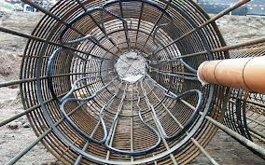

Slide 8
Overall system
Primary unit
  Ground heat exchangers
  Extracting and injecting heat to surrounding soil
  In summer ground is heat sink
  In winter ground is heat source
Heat pump
  responsible for driving the flow of heat transfer fluid through the subsurface pipes
  compressor and expansion valve
  electrical energy is required to drive the heat pump

Slide 9
Secondary unit
  Pipes embedded in floors and walls of buildings
  Utilise the extracted thermal energy for heating purposes during the winter
  Receives unwanted heat from surroundings in summer for transfer into the ground

Slide 10
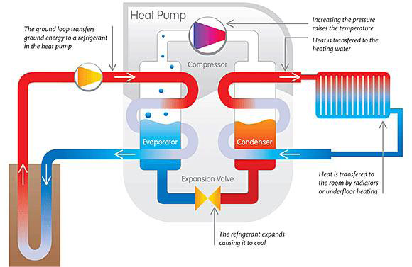
Working of the system

Slide 11
Ground source heat pump systems
Open loop system
Closed loop system
directly use the ground’s thermal storage medium
Ground water is directly taken for heating purpose and after that it is injected back to aquifer
heat transfer process is indirectly between soil and a HCF flowing through pipes
Energy piles are a form of closed-loop system
It may be horizontal or vertical loops

Slide 12
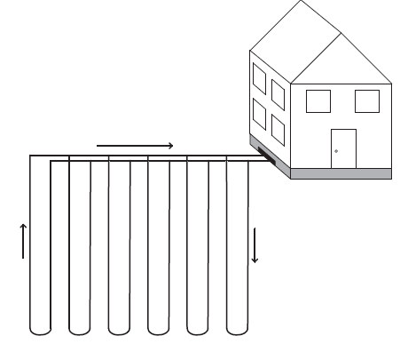
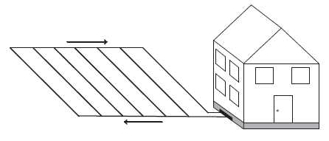
Closed loop system
Vertical closed loop
Horizontal closed loop

Slide 13
Open loop system

Slide 14
Materials
Energy piles
  Precast or cast in situ reinforced concrete
  Steel
  Grout
Absorber pipes
  made of high-density polyethylene(HDPE)
  Pipe diameters range from 20 to 25 mm
  lengths will depend on pile length and performance requirements

Slide 15
Contd..
Heat carrying fluid
  transmits or receives heat to and from the ground
  For warmer climate water is sufficient
  For cooler climates, antifreeze solutions such as water and glycol mixtures, saline solutions, brine, potassium acetate or even methanol are possible
Shape of loops
  installed pipes adopt the form of continuous loops of certain shapes
  Single, double and triple U-shaped pipes and W shaped pipes

Slide 16
Shape of loops

Slide 17
Performance assessment
The coefficient of performance (COP)
  indicates how much heat can be gained for a unit input of electrical energy
  Design aims for values between 2 and 4

Slide 18
Design factors
Geological strata
Geotechnical properties
Geothermal properties
Hydro geological properties
Mineralogical and geochemical soil properties

Slide 19
Applications
Applications of ground source heat pumps
  Heating and cooling demands of tunnels
  For clearing snow and ice in railway platforms in cooler countries
  Heating and cooling demands for growing vegetables in greenhouses
  drying crops
  heating water at fish farms
  pasteurizing milk

Slide 20
A railway platform in lauterberg, germany

Slide 21
Thermal imbalance in cooler climate
Coupling of solar panels with geothermal systems
Solar collectors recharge the ground with thermal energy during summer
This energy meets heating requirements

Slide 22
Thermal imbalance in warmer climate
Can’t meet the full cooling load
Integrated soil cold storage and ground-source heat pump system
charges cold energy to the soil at night
soil will exhibit lower temperatures during the day

Slide 23
Advantages
Sustainable and Renewable Energy Source
50% reduction in carbon emissions
Gives fuel cost savings
No local emissions or pollution
Efficiency of the systems is higher than that of air-source heat pumps

Slide 24
Disadvantages
Efficiency of the systems reduces when substantial temperature fluctuations take place during the year
If the soil is dry sand or gravel, deeper piles and a larger area of absorbers are required which increase costs and reduce economic benefits
Improper setup, misuse and designs have been resulting in inadequate flow rates, leaks within the system, inadequate heat exchange
A heavier regulation is necessary to ensure long-term performance and prevention of short-circuiting

Slide 25
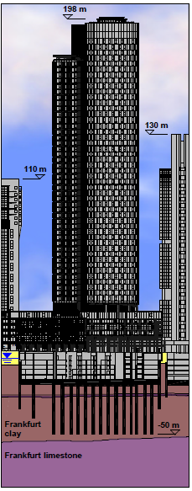
Case study
Main Tower – Frankfurt, Germany

Slide 26
Main Tower – Frankfurt, Germany
Building of height 200 m, founded on a combined pile-raft foundation
112 piles with diameter of 1.5 m were installed of length 20 to 30m
bored piles of the retaining wall are part of the foundation system & they transfer the loads in addition to the 112 foundation piles
piles of the foundations and partly of the retaining wall are used for the eco-friendly heating and cooling of the building

Slide 27
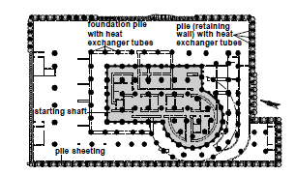

Slide 28
Conclusions
Highly efficient heating technologies which reduces CO2 emissions
Many variations of geothermal systems for heating exist, with different configurations
Energy piles have the potential to reduce energy demand in built structures
This system utilize significantly less energy to heat a building than alternative heating systems

Slide 29
References
Website:www.techjetz.com,www.techdid.com
Preene M, Powrie W. Ground energy systems: from analysis to geotechnical design. Ge´otechnique 2009
Kavanaugh S. Ground source heat pumps. ASHRAE Journal 1998
Hepbasli A. Current status of geothermal energy applications in Turkey.
Energy Sources 2003
Brandl H. Energy foundations and other thermo-active ground structures. Ge´otechnique 2006
Rawlings RHD, Sykulski JR. Ground source heat pumps: a technology review.
Building Service Engineering 1999

Slide 30
Thank You

